Slide 1


Software Engineering
Zhang Shuang
zhangs@swc.neu.edu.cn

Slide 2
Welcome to
Software Engineering
Zhang Shuang, zhangs@swc.neu.edu.cn

Slide 3
Software
Engineering
Case Study
Project Mgmt
Practices
SW Architecture
& Design Pattern
Software
Testing
Requirement
Project
Software College, Zhang Shuang, Zhangs914@163.com

Slide 4
Software Engineering
Reference Book:
Object-Oriented Software Engineering
(English Version)
Stephen R. Schach
面向对象软件工程
（中文版）
Zhang Shuang, zhangs@swc.neu.edu.cn

Slide 5
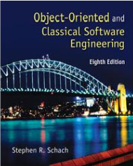
Software Engineering
Reference Book:
Object-Oriented & Classical Software Engineering
(English Version)
5th~8th Edition
Stephen R. Schach
面向对象与传统软件工程
（中文版）
Zhang Shuang, zhangs@swc.neu.edu.cn

Slide 6

Software Engineering
Other Reference Books:
Software Engineering, 9th edition, Ian Summerville, 机械工业出版社
Software Engineering: A practitioner ’s Approach，5th edition, Roger S. Pressman，机械工业出版社
Object-oriented Software Engineering ----Using UML, Patterns and Java, 3rd edition, Bernd Bruegge, Allen H. Dutoit, 清华大学出版社
……
Zhang Shuang, zhangs@swc.neu.edu.cn

Slide 7

Software Engineering
Course on “software engineering”
Goal ---- to deliver software that is:
  On schedule
  On budget
  Fault-free
  Meets client needs
Broad scope
Zhang Shuang, zhangs@swc.neu.edu.cn
Notes:
在学习软件工程及软件工程管理之前，我们可以看到，机械工业以至一般的加工业，都已经有了上百年的历史，产品的生产流程及工程、车间、工种等的继续设置和角色分工都有了成熟的模式。但是，软件企业及其软件产品的生产历史不长，加之软件本身的智力劳动的特性，软件作为产品的生产流程及其相应的管理活动，还远远没有一个成熟的模式。
为了“更快、更好、更便宜”地开发软件产品，既要有技术措施（方法和工具），又要有必要的组织管理措施。从学科发展角度出发，人们很自然地想到了软件工程。因为软件工程正是从管理和技术两方面研究如何采用工程的概念、原理和技术方法并加以综合，知道开发人员更好地开发和维护计算机软件的一门新的学科。

Slide 8
Software Engineering
Bilingual course:
  English reference book
  English demo
  English exam
Why bilingual for SE?
How to learn SE?
  Learn by doing
Zhang Shuang, zhangs@swc.neu.edu.cn
Notes:
The reasons of so much English for SE:
The latest knowledge and information is in English. Chinese version is late than English ones for at least half a year.
Usually, there are some errors in Chinese version, because the translator does not understand completely.
So, understand software in English is very important for software person.
“Software Engineering” is a course of engineering. Learn by doing, and discussing, rather than by listening.
Surely listening is more comfortable than doing.

Slide 9

Software Engineering
Grading:
50%: final exam
20%: performance on 辽宁省慕课平台
30%: team project + performance in class
Zhang Shuang, zhangs@swc.neu.edu.cn

Slide 10
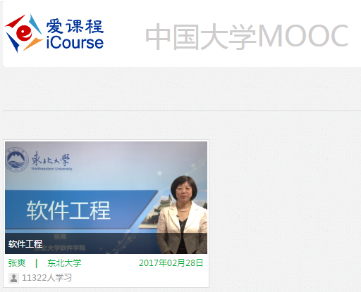
Course Resources
  Course material is available on
    爱课程—中国大学MOOC平台
Zhang Shuang, zhangs@swc.neu.edu.cn

Slide 11
Course Resources
  Course material is available on
    辽宁省高校慕课平台
    https://uoc.upln.cn/lessons/showall
    辽宁省慕课平台（English Version）http://sharecourse.upln.cn/pdt/sharecourse/index.html
Zhang Shuang, zhangs@swc.neu.edu.cn

Slide 12

Experiment ---- Team Project
4 ~ 5 students (including 1 girl student) / team
1 project / team
  Hotel Mgmt. System
  Dormitory Mgmt. System
  Student Mgmt. System
  ……
Zhang Shuang, zhangs@swc.neu.edu.cn

Slide 13
What to Learn ?
Introduction to Software Engineering
Software Life-Cycle
Requirements
Introduction to Objects
Object-Oriented Analysis
Object-Oriented Design
Implementation & Integration
Maintenance Phase
Software Life-Cycle Modules
Zhang Shuang, zhangs@swc.neu.edu.cn

Slide 14
Thank You !

